Slide 1
Cardinality Basics
Dr. Anne Powell
CMIS563

Slide 2
More about relationships
Degree
Number of entities involved
Typical
Unary (e.g. is married to)
Binary (most common)
The relationship “lives in” is of what degree? (as in Student “lives in” Residence Hall)

Slide 3
And another thing…
Cardinality
Number of instances of one entity that are associated with another
Minimum and maximum – lower and upper bounds on the number of instances
Typically: 0, 1, many – deviations can be noted
Mandatory and optional

Slide 4
Cardinality
Minimum
Zero = may ( )
One = must ( )
Maximum
One ( )
Many ( )
Possibilities:

Slide 5
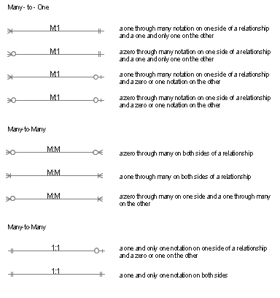

Slide 6


Reading ERDs

Slide 7


Reading ERDs (continued)

Slide 8

Binary Example
What does this tell you?
Read the relationships both directions.

Slide 9
